Slide 1
Political Principles
7th Grade Civics

Slide 2

American Constitutional Government

Slide 3
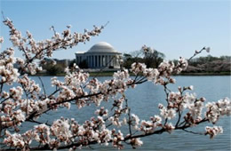
BIG IDEA

Slide 4
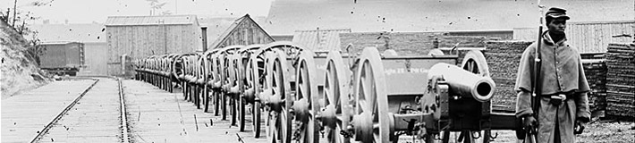
Consent of the Governed

Slide 5
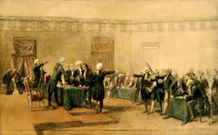
Limited Government

Slide 6
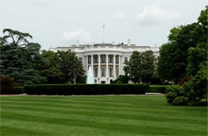
Rule of Law

Slide 7
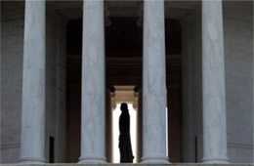
Democracy

Slide 8

Representative Government

Slide 9

Historical Character
Voki For Web

Slide 10
Sources
Photographs retrieved from : http://www.pics4learning.com/

